Slide 2
G-6235 Corunna Rd. flint, mi 48532
CORUNNA
Rd.

Slide 3
Our Website
https://www.gecs-inc.org

Slide 4
810-396-1100
www.gecs-inc.org

Slide 5
Meet GECS’ CEO
Over 42 years of experience working in Education
Received a Masters degree from Michigan State University in Reading and a Masters degree in Education Leadership from Eastern Michigan University.
After being an elementary school teacher, Jeff was an elementary school principal.
Superintendent at Kearsley for 15 years
Jeff Morgan
GECS, CEO

Slide 6
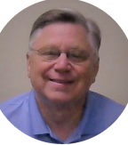
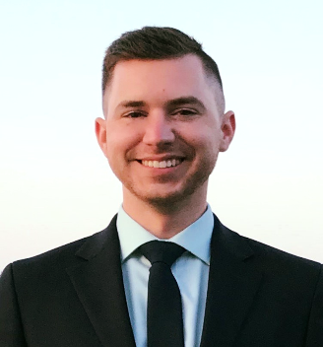
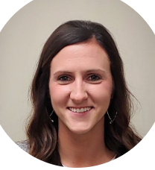
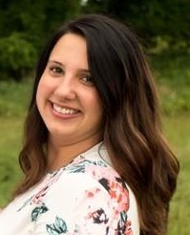
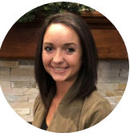
Meet Our Team
TOM MORGAN
Kacie Harris
NICOLE BROWN
MARK MORGAN, JD
JEFF MORGAN
CASEY SHAFER
HR ASSISTANT
DIRECTOR OF HR
AND COMPLIANCE
HR ASSISTANT
BENEFITS SPECIALIST
CHIEF EXECUTIVE OFFICER
HR ASSISTANT
BS-Health Care
Administration
MA- Education Leadership
MA- Reading
BA- Elementary Education
BS-Exercise Science & Kinesiology
BS-Agribusiness
BS-Allied Health Science
JD- Law
MS- Human Resource
Management
BA- Political Science

Slide 7
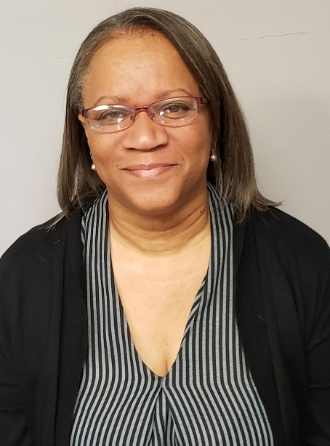
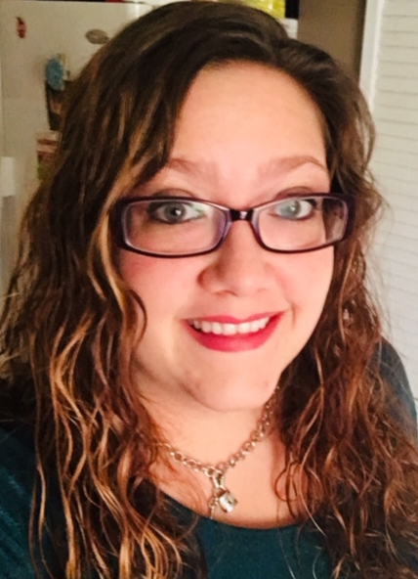
Meet our business services’ team
Seth Brady
emily covers
payroll
Carla johnson
Kira mccain
payroll
Accounts payable
Accounts payable & Payroll
Payroll

Slide 8
History of GECS and Who We Are
Genesee Education Consultant Services, Inc. (GECS) is a non profit corporation under the Genesee County Educational Foundation.
Our first employees were hired in January, 2012.
GECS is an employment agency providing quality employees to school districts throughout Genesee, Lapeer, and Oakland Counties.
We provide cost-effective, collaborative employee services.
As of 2019-2020, we have 28 contracted schools!

Slide 9
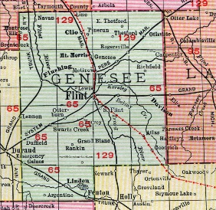
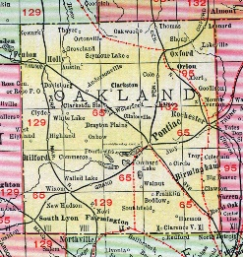
School Contracts
Lapeer County
Genesee County
Atherton Community Schools
Bendle Public Schools
Bentley Community Schools
Carman Ainsworth Community Schools
Clio Area Schools
Davison Community Schools
Fenton Area Public Schools
Flushing Community Schools
Genesee School District
GISD (Genesee Intermediate School District)
Goodrich Area Schools
Kearsley Community Schools
Oakland County
Almont Community Schools
Dryden Community Schools
Imlay City Community Schools
North Branch Area Community Schools
Lake Fenton Community Schools
Linden Community Schools
Michigan School for the Deaf
Montrose Community Schools
Mt. Morris Consolidated Schools
Sand Castles
St. John – Davison
Westwood Heights Schools
Woodland Park Academy
Rochester Community Schools
NEW CONTRACTS (2019-2020)
*Flint Cultural Center Academy
*GISD Drivers

Slide 10
Employee Growth
2019-2020

Slide 11
Percent increase W-2’s from
year to year:
2012 to 2013= 478%
2013 to 2014= 58%
2014 to 2015= 12%
2015-2016= 20%
2016 to 2017= 10%
2017-2018= 12%

Slide 12
Percent increase from year to year:
15-16 to 16-17: 20%
16-17 to 17-18: 0%
17-18 to 18-19: 21%
AVERAGE GROWTH:14%
Average number of checks by year:
2015-2016: 1003
2016-2017: 1200
2017-2018: 1194
2018-2019: 1450

Slide 13
GECS’ Growth
2012-13
2013-14
2014-15
2015-16
2016-17
2017-18
2018-19
333%
Salaries & Benefits Growth
43%
Salaries & Benefits Growth
11%
Salaries & Benefits Growth
30%
Salaries & Benefits Growth
10%
Salaries & Benefits Growth
26%
Salaries & Benefits Growth
GECS hires it’s first 36 employees
919%
Employment Growth
99%
Employment Growth
12%
Employment Growth
19%
Employment Growth
7%
Employment Growth
19%
Employment Growth

Slide 14
Services
Employer of Record
Personnel File Maintenance
Job Posting/Advertising
Enrollment of Employees
Attendance Monitoring
Payroll Services
Provides Notice Reasonable Assurance
Online Trainings
Department of Human Resources Clearance
Enrollment of Insurance Benefits
Liability Insurance
Workers Compensation Insurance
Provides 403(b) Vendor

Slide 15
Pay # | From Monday | Through Sunday | Pay Date | Timesheet Due
1 | 6/7/2019 | 6/30/2019 | 7/12/2019 | 7/1/2019
2 | 7/1/2019 | 7/14/2019 | 7/26/2019 | 7/15/2019
3 | 7/15/2019 | 7/28/2019 | 8/9/2019 | 7/29/2019
4 | 7/29/2019 | 8/11/2019 | 8/23/2019 | 8/12/2019
5 | 8/12/2019 | 8/25/2019 | 9/6/2019 | 8/26/2019
6 | 8/26/2019 | 9/8/2019 | 9/20/2019 | 9/9/2019
7 | 9/9/2019 | 9/22/2019 | 10/4/2019 | 9/23/2019
8 | 9/23/2019 | 10/6/2019 | 10/18/2019 | 10/7/2019
9 | 10/7/2019 | 10/20/2019 | 11/1/2019 | 10/21/2019
10 | 10/21/2019 | 11/3/2019 | 11/15/2019 | 11/4/2019
11 | 11/4/2019 | 11/17/2019 | 11/29/2019 | 11/18/2019
12 | 11/18/2019 | 12/1/2019 | 12/13/2019 | 12/2/2019
13 | 12/2/2019 | 12/15/2019 | 12/27/2019 | 12/16/2019
Quarter 3
Quarter 4
2019-2020 PAYROLL SCHEDULE

Slide 16
Pay # | From Monday | Through Sunday | Pay Date | Timesheet Due
14 | 12/16/2019 | 12/29/2019 | 1/10/2020 | 12/30/2019
15 | 12/30/2019 | 1/12/2020 | 1/10/2020 | 12/30/2019
16 | 1/13/2020 | 1/26/2020 | 2/7/2020 | 1/27/2020
17 | 1/27/2020 | 2/9/2020 | 2/21/2020 | 2/10/2020
18 | 2/10/2020 | 2/23/2020 | 3/6/2020 | 2/24/2020
19 | 2/24/2020 | 3/8/2020 | 3/20/2020 | 3/9/2020
20 | 3/9/2020 | 3/22/2020 | 4/3/2020 | 3/23/2020
21 | 3/23/2020 | 4/5/2020 | 4/17/2020 | 4/6/2020
22 | 4/6/2020 | 4/19/2020 | 5/1/2020 | 4/20/2020
23 | 4/20/2020 | 5/3/2020 | 5/15/2020 | 5/4/2020
24 | 5/4/2020 | 5/17/2020 | 5/29/2020 | 5/18/2020
25 | 5/18/2020 | 5/31/2020 | 6/12/2020 | 6/1/2020
26 | 6/1/2020 | 6/14/2020 | 6/26/2020 | 6/15/2020
1 | 6/15/2020 | 6/28/2020 | 7/10/2020 | 6/29/2020
2 | 6/29/2020 | 7/12/2020 | 7/24/2020 | 7/13/2020
Quarter 1
Quarter 2

Slide 17
Family
Accompanist
Accountants
After School Program Facilitators
Aides
Attendance Liaisons
Base Camp Facilitators
Behavior Health Associates
Bus Aides
Bus Drivers
Co-ops
Coaches
Cooks
Custodians
Data Analysts
Directors
English Language Learner (ELL) Facilitators
Fingerprint Technicians
Groundskeepers
GSRP Teachers
Head Start Teachers
Lunchroom Monitors
Maintenance
Mental Health Coordinators
Nurses
Nutrition Facilitators
Paraprofessionals
PC/Equipment Technicians
Receptionists
Registered Dieticians
Secretaries
Security
Sign Language Assistants
Social Workers
Special Events Staff/ Game Help
Substitute Teachers
Teachers
Tutors
Youth Development Leaders

Slide 18
Follow Us on Social Media!
@GECS1
Genesee Education Consultant Services
(GECS)
@GECSINC

